Slide 1

Mars Analog Environments & New Mexico Test Site Selection
HERMES Research Summary
By: Jathan Barreto

Slide 2
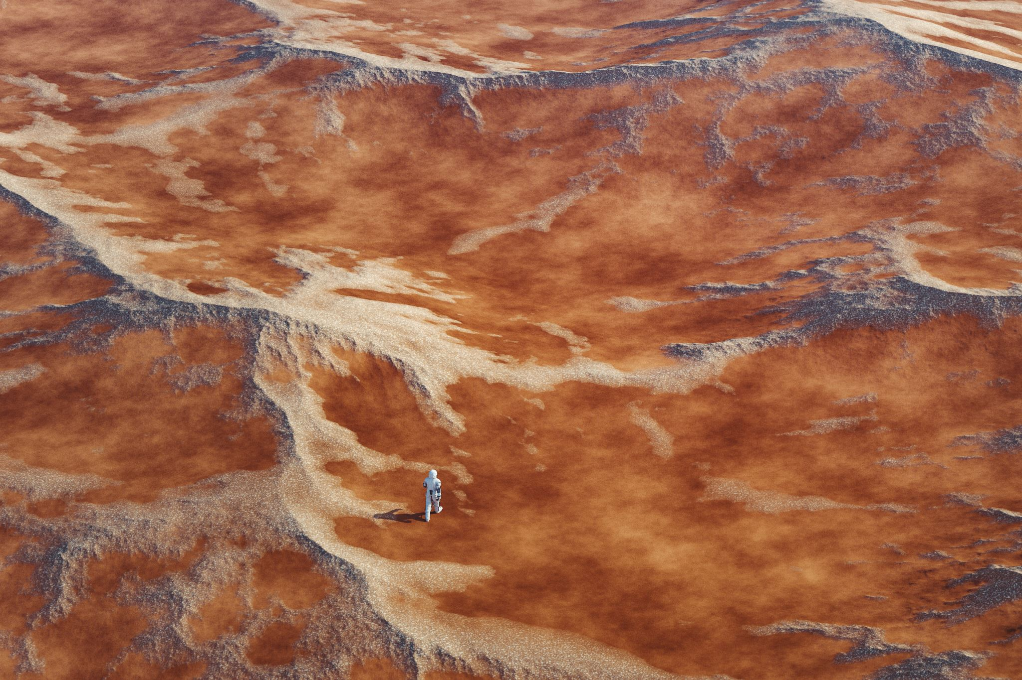
Established Mars Analog Sites
• Devon Island – polar desert, impact crater operations
• MDRS (Utah) – EVA and habitat simulations
• HI-SEAS (Hawaii) – basaltic volcanic terrain
• Atacama Desert (Chile) – hyper-arid testing
• Iceland – volcanic flows and glacial interactions

Slide 3
What Makes Terrain “Mars-like”
• Basaltic geology and dust-prone soil
• Sparse vegetation and dry climate
• Harsh environment and operational isolation
• Terrain challenges for mobility and comms

Slide 4
Why New Mexico
• Gypsum dune fields at White Sands
• Basaltic lava flows (Carrizozo, El Malpais)
• Dry desert climate and Mars‑like visibility challenges
• Close access to facilities and logistics support

Slide 5
WSMR & Operational Considerations
• Controlled land and restricted airspace
• Support for RF testing and GPS-denied scenarios
• BLM permitting for nearby areas
• Weather: dust, heat, winds, cold nights

Slide 6
Key Takeaways for HERMES Testing
Real-world environments help validate mission operations
New Mexico provides diverse Mars-like terrain in accessible locations
White Sands Missile Range allows controlled RF and GPS-denied testing
BLM rules guide responsible land use outside WSMR
Lessons from MDRS, HI-SEAS, and Atacama missions inform our approach
Field testing reduces risk before future Mars deployment

Slide 7
References
Mars Society. (n.d.). Mars Desert Research Station (MDRS). https://mars-desert-research-station.raiselysite.com/MDRS
NASA. (n.d.). HI-SEAS Analog Missions. https://earth.gsfc.nasa.gov/acd/campaigns/hi-seas
White Sands Missile Range. (n.d.). Official public information. https://home.army.mil/wsmr/
Bureau of Land Management. (n.d.). Special Recreation Permits. https://www.blm.gov/programs/recreation/permits-and-passes/special-recreation-permits
NASA. (n.d.). Atacama Desert research campaigns and analog mission documentation. https://pmc.ncbi.nlm.nih.gov/articles/PMC10750311/
Haughton-Mars Project and FMARS information. (The Mars Institute). https://www.marsinstitute.no/hmp

